Slide 1
https://www.figma.com/proto/n5YkgShsxpZHGeIE59caZm/Mike-Rustell---UI?node-id=519-4404&t=3IYJ0AN9rvhtO6ls-0&scaling=min-zoom&page-id=0%3A1&starting-point-node-id=519%3A4404&show-proto-sidebar=1
I will need the ability to update all text and ideally run this from

Slide 2
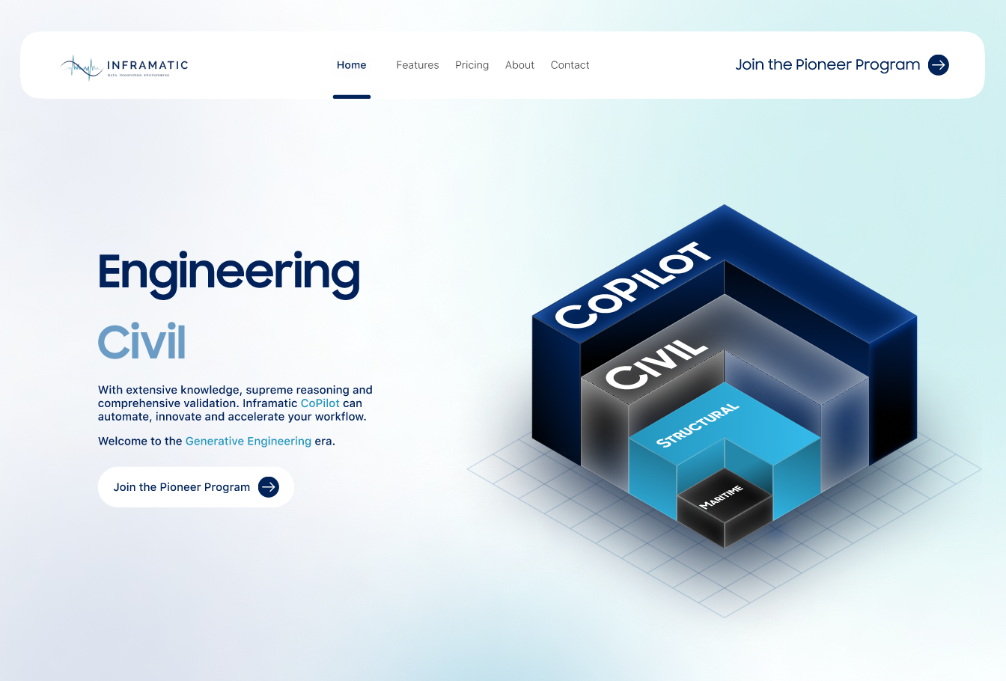




Slide 3

Introducing the Engineering CoPilot, a state-of-the-art Generative Engineering system designed to curate, validate, and apply technical knowledge. It can help you with routine, and not so routine engineering tasks.
Our mission is to give you AI superpowers with the level of transparency and control you need to solve the biggest global challenges.
Join us to transform the industry, and then the World.

Slide 4


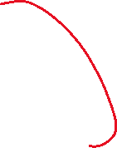

Slide 5
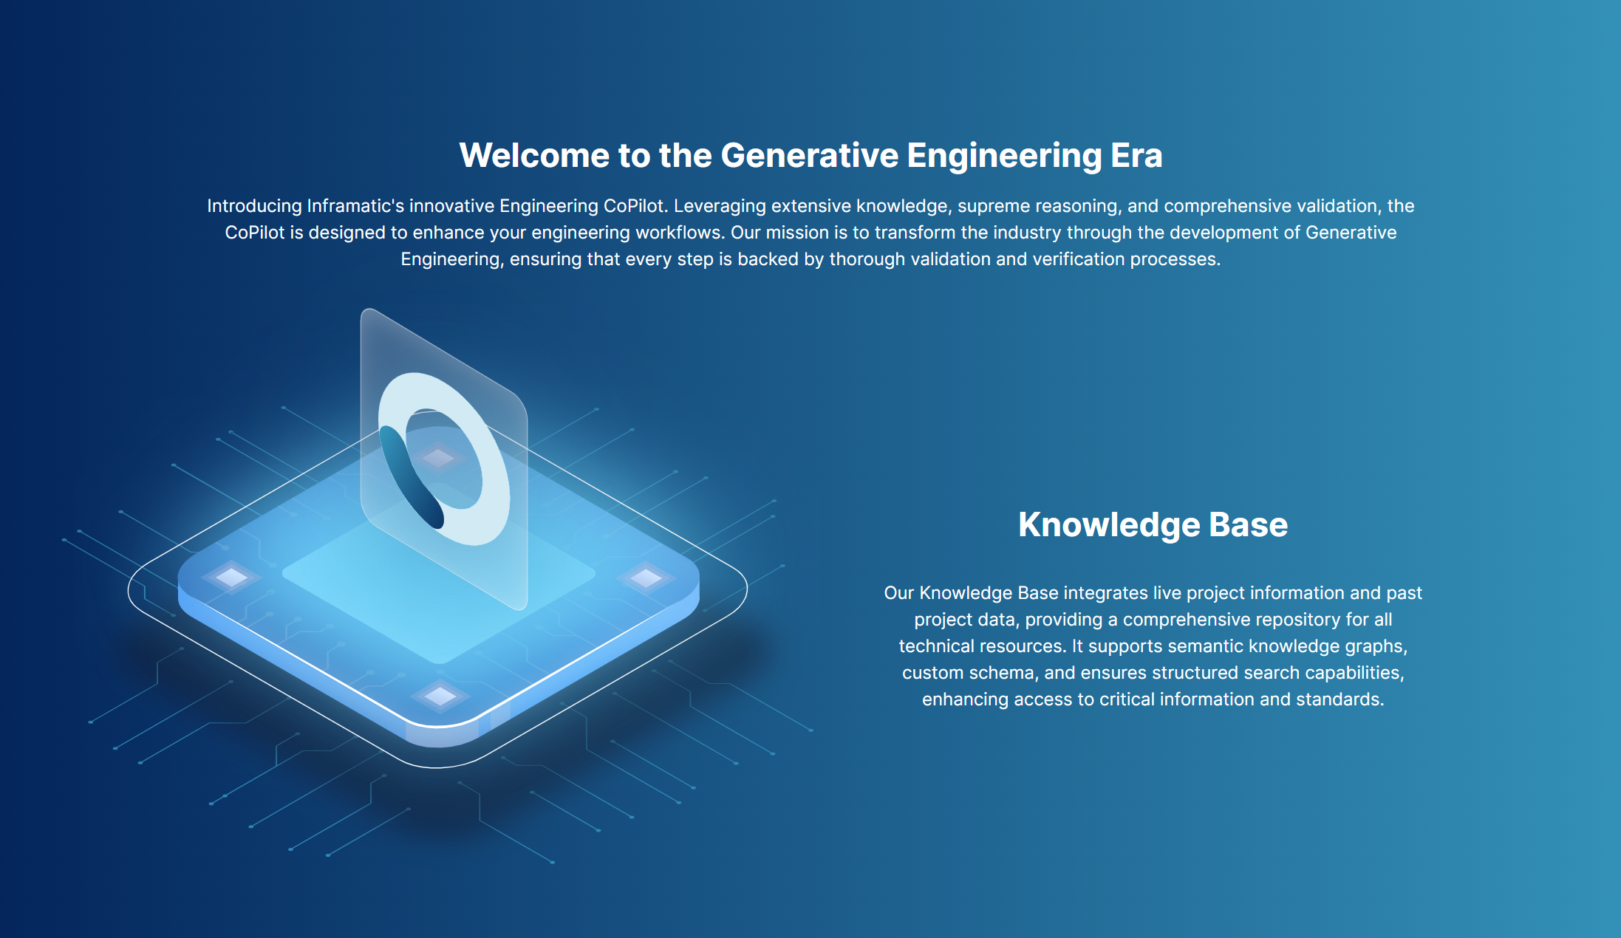


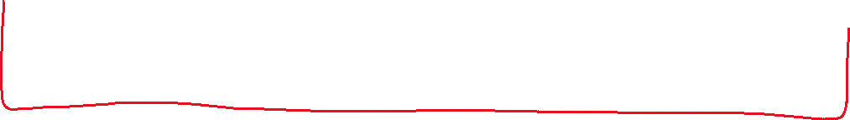


Slide 6
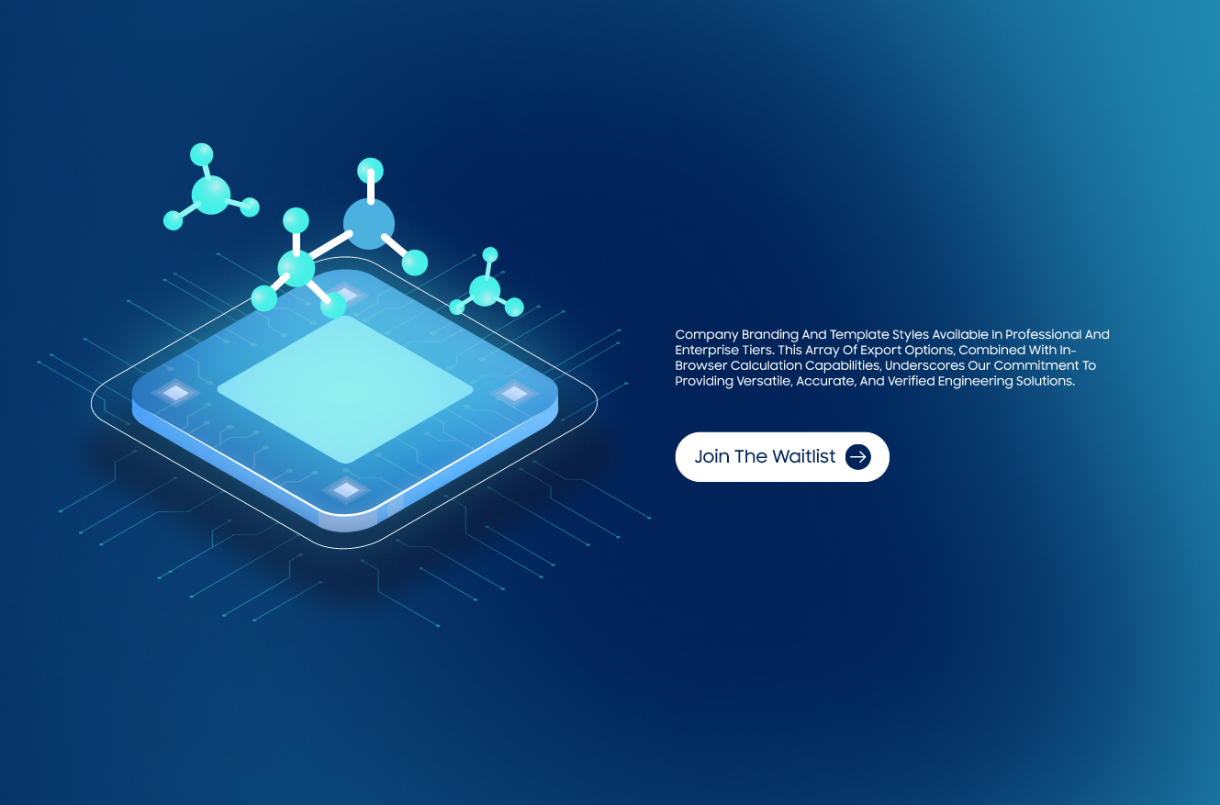

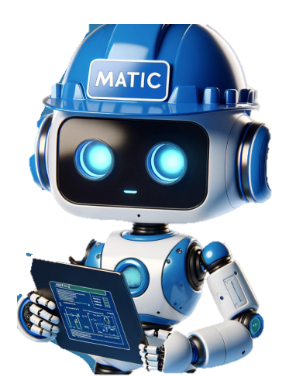



Slide 7
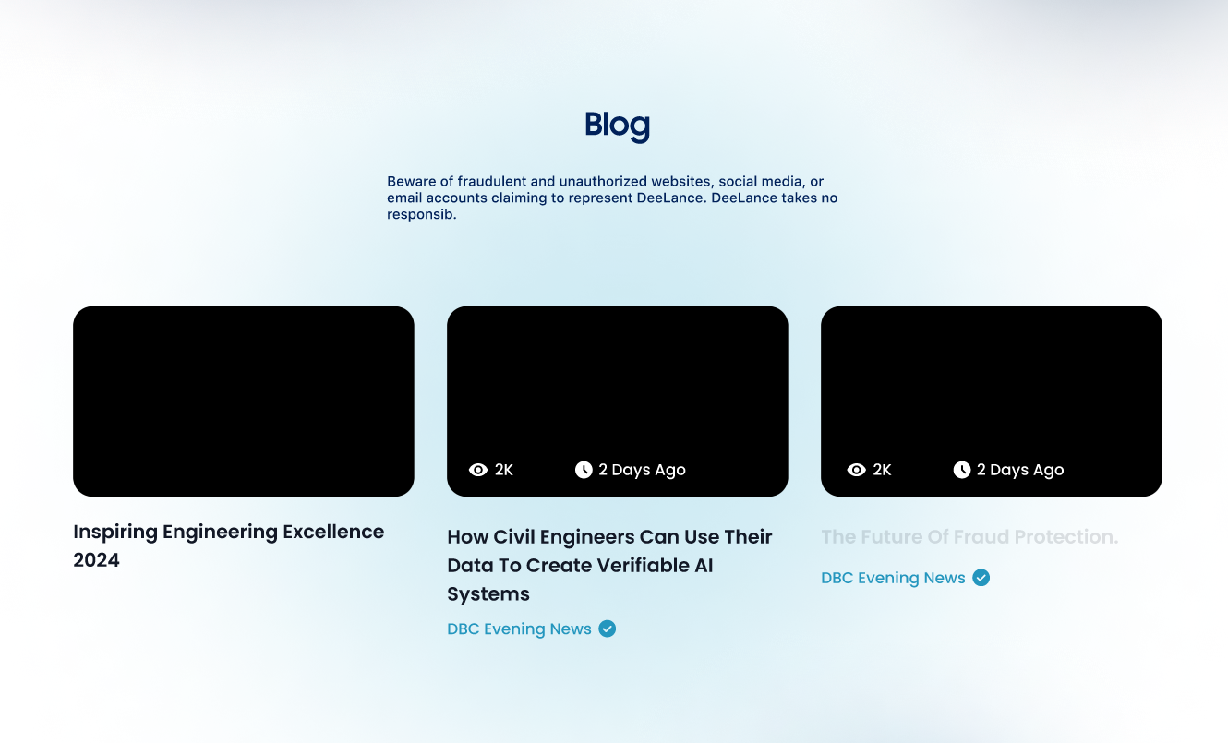

Slide 8
